Slide 1


IMDb: Genre vs Ratings
By: Geormal Moore

Slide 2


What’s the problem?
Almost everyone around the world watches or have watched movies/movie in their lifetime. Depending on weather the movie is good or bad is generally based on the watchers opinion, but can also be correlated to other things such as box office revenue,
movie budget, or possibly even the genre
What is the relationship between Genre and Ratings and how can it increase revenue?

Slide 3


Benefits
Benefits of this can include a movie company producing the best ratings possible because of genre appeal. This in turn can and will increase profit and give them a good box office standing in terms of revenue.
Discovering the hotspot in terms of movie genre and differentiating your film variety can make certain films stand out among the others

Slide 4
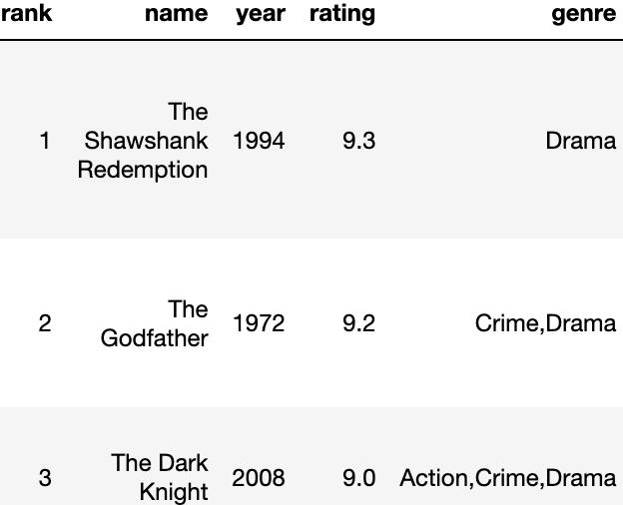
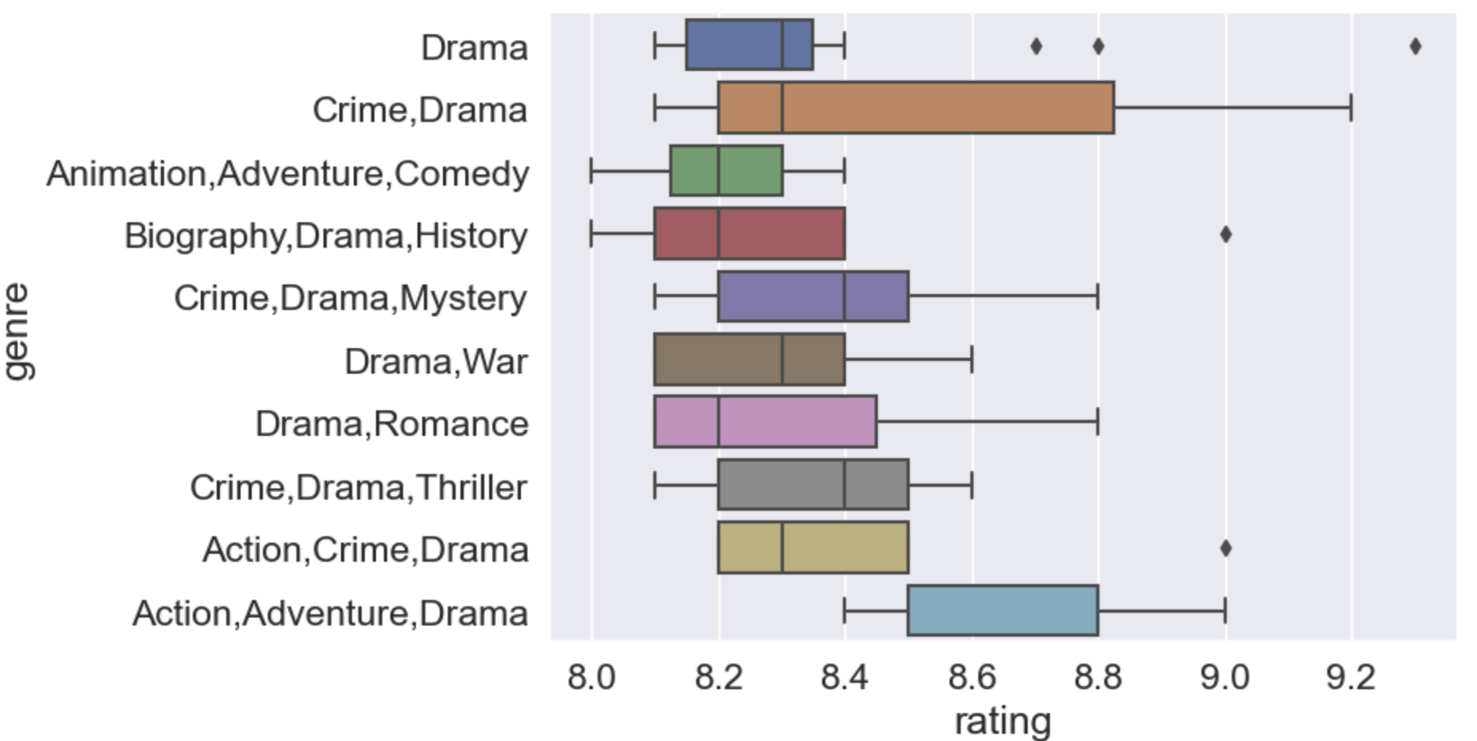
Findings
Box and Whisker Plot: Correlation between Genre and Ratings
Top 3 Highest rated films
Notes:
Based on the findings, we can see that in the first graph the movie titles “The Shawshank Redemption”, “The Godfather”, and “The Dark Knight Rises” all are in the top three of highest rated films
And as you can see all at least fall into the category of “Drama”. This in turn correlates with the other graph below which displays the top ten highest rated genres in the dataset. As you can see, most if not all of them consists of the genre of “Drama”

Slide 5
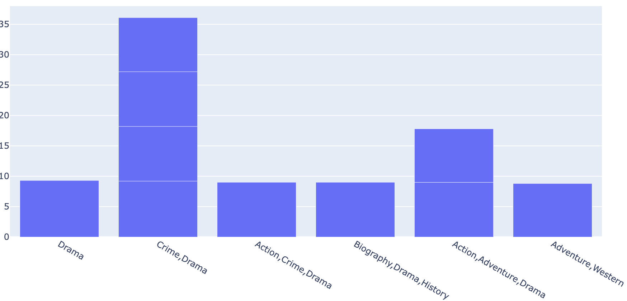
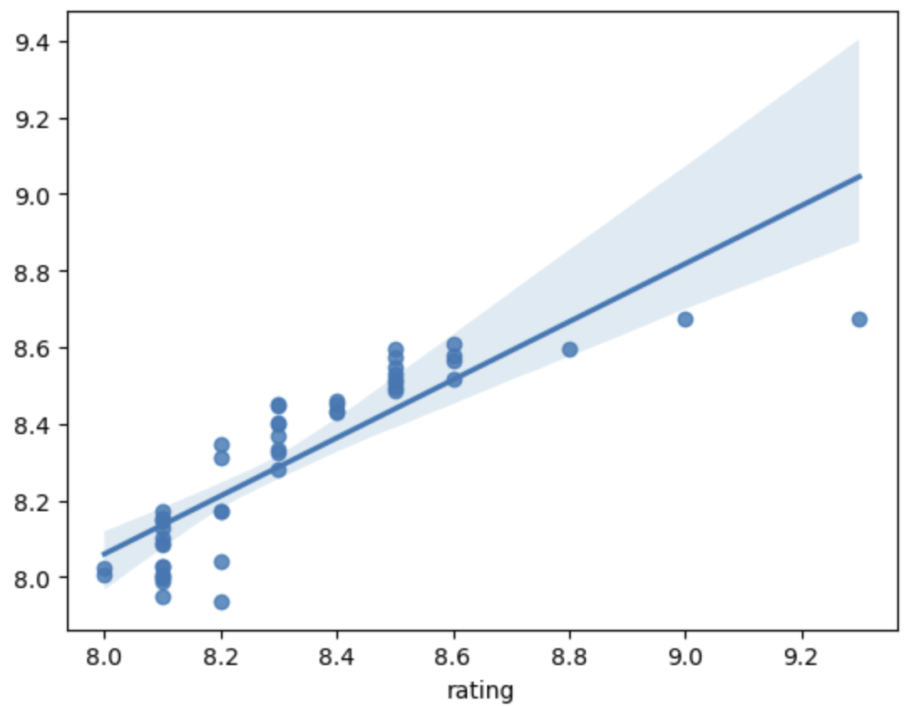
Recommendations and Future Purposes
Some recommendations that I would suggest in order to increase the likelihood of having a successful film rating would be to create films within the category of drama.
In order to increase movie ratings we would need to start experimenting with cross genre films which combines different genre elements. So the next time you’re wondering why certain films and movies receive the praise that they do, check the genre and you get your answer.
Notes:
In order to increase movie ratings we would need to start experimenting with cross genre films which combines different genre elements. So the next time you’re wondering why certain films and movies receive the praise that they do, check the genre and you get your answer.
The model predictions were not the most accurate but nonetheless most of the data points matched up pretty nicely

Slide 6

Thank you!

